Slide 1

Smart Campus Network Health Monitoring Dashboard
Guided by Dr.JaiSharma K
Presented by
Nithiya shree G –[1972260031]
Sushmitha G – [1972260028]
Shylesh kumar S – [1925260085]

Slide 2
ABSTRACT
A campus network connects many devices and services.
Monitoring a large network manually is difficult
Our project provides a centralized network monitoring dashboard
It displays device status and network health information
It helps identify network problems quickly.
The system supports efficient network management.

Slide 3
CHAPTER 1- INTRODUCTION
Campus networks support learning, communication and administration
They contain routers, switches, computers, servers and Wi-Fi devices.
Network failures can affect important campus services.
Continuous monitoring helps detect problems early.
Our dashboard provides a simple view of network health.

Slide 4
PROBLEM STATEMENT
Manual monitoring of multiple devices takes time
Network information may be distributed across different devices
Device failures may not be noticed immediately.
It can be difficult to understand overall network performance.
Troubleshooting may take longer without a centralized monitoring system.
Proposed Solution Develop a centralized dashboard that collects, analyzes and displays campus network health information in an easy-to-understand format.

Slide 5
OBJECTIVES
To monitor the status of campus network devices
To identify active and inactive devices.
To monitor important network performance parameters.
To display network health in a simple visual format.
To detect abnormal network conditions.
To provide alerts or warnings when required.
To reduce manual monitoring effort.
To support faster troubleshooting.

Slide 6
SCOPE OF THE PROJECT
The project focuses on:
Network device monitoring.
Device availability and connectivity
Network health monitoring.
Performance visualization.
Bandwidth and latency monitoring.
Alert generation.
Centralized dashboard-based monitoring
Target Users:
Network administrators and campus IT support teams.

Slide 7
CHAPTER 2- LITERATURE REVIEW
Network monitoring is important for maintaining reliable network performance.
Existing monitoring systems collect information about devices, traffic and connectivity.
These systems help administrators identify faults and performance issues.
Data visualization makes network information easier to understand.
Smart campus systems use technology to improve campus infrastructure management
Our project combines network monitoring and visualization in a simple campus-focused dashboard.

Slide 8
EXISTING SYSTEM
Existing tools can monitor network devices and performance
Administrators can view information such as device availability and network traffic.
Some monitoring tools can be complex to configure and use.
Information may require checking multiple interfaces or devices.
Manual analysis can increase the time required to identify problems
A simple centralized campus-oriented dashboard can make this process easier

Slide 9
PROPOSED SYSTEM
Smart Campus Network Health Monitoring information from monitored network devices.
Processes and analyses the collected data.
Displays device and network health information in one dashboard.
Shows active, inactive and unhealthy devices.
Uses graphs and indicators for better visualization.
Highlights abnormal conditions using alerts or warnings.
Helps administrators identify and respond to problems quickly.

Slide 10
SYSTEM ARCHITECTURE
Network Devices
↓
Data Collection
↓
Data Processing
↓
Network Health Analysis
↓
Monitoring Dashboard
↓
Administrator
Main Components , Network devices, Data collection processing module, Health analysis module, Dashboard Alert system .

Slide 11
DASHBOARD FEATURES
The dashboard provides:
Active Devices – Devices currently available.
Network Health – Overall network condition.
Bandwidth Usage – Network usage information.
Latency – Communication delay.
Inactive Devices – Devices that are unavailable.
Total Devices – Number of monitored devices.
Connectivity Status – Current connection condition.
Alerts – Warnings about abnormal conditions.
Graphs and Charts – Visual representation of network performance.

Slide 12
WORKING PRINCIPLE
The system collects information from network devices.
The collected information is processed by the system.
Important network parameters are analyzed.
The system determines the health status of the devices.
The results are displayed on the dashboard.
Graphs and indicators provide a clear view of network performance.
Abnormal conditions are highlighted for the administrator.
The administrator can take appropriate troubleshoot

Slide 13
DASHBOARD FEATURES
The dashboard provides:
Total Devices – Number of monitored devices.
Active Devices – Devices currently available
Inactive Devices – Devices that are unavailable.
Network Health – Overall network condition.
Bandwidth Usage – Network usage information.
Latency – Communication delay.
Connectivity Status – Current connection condition.
Alerts – Warnings about abnormal conditions.
Graphs and Charts – Visual representation of network performance

Slide 14
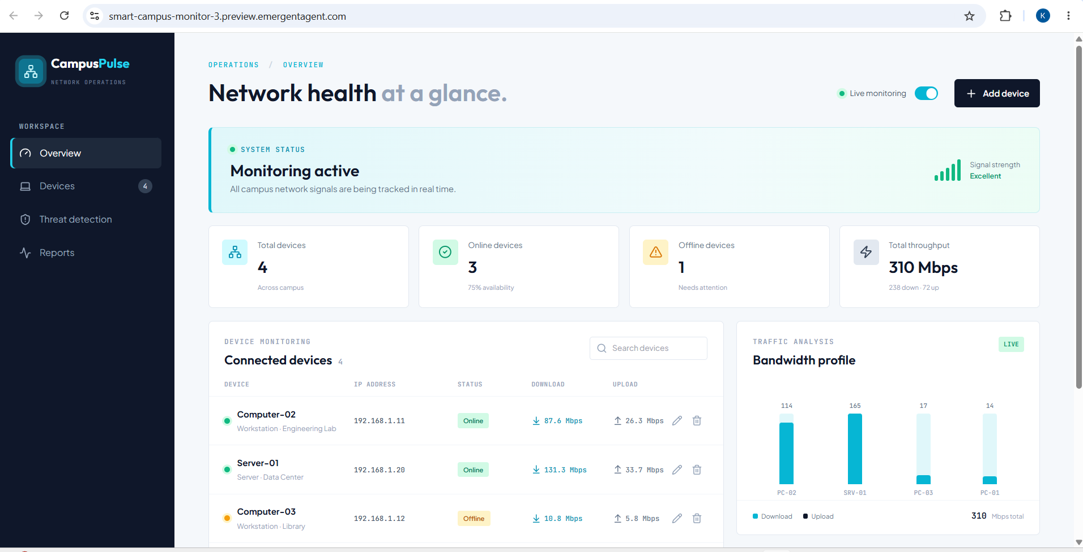

Slide 15
SUSTAINABILITY, ETHICS, SAFETY AND SECURITY
Sustainability Reduces the need for continuous manual monitoring.
Helps in efficient use of network resources.
Ethics Network data should be accessed only for authorized purposes.
User privacy should be respected.
Safety Network configurations should be changed only by authorized personnel.
Monitoring should not disturb normal network operation.
SecurityDashboard access should be restricted.
Authentication should be provided.

Slide 16
ENGINEERING TRADE-OFFS
Accuracy: Accurate data is required for reliable network health information.
Performance: Monitoring should not create unnecessary network traffic.
Security: Access must be limited to authorized users.
Cost: The system should use resources efficiently.
Usability: The dashboard should remain simple and easy to understand.
Real-time Monitoring: More frequent monitoring gives updated information but requires more system resources.

Slide 17
TECHNOLOGIES USED
Software Python – Data processing and monitoring logic.
HTML – Dashboard structure.
CSS – Dashboard layout and design.
JavaScript – Interactive dashboard features.
Networking IP addressing
Routers and switches
Device connectivity
Network performance parameters
Visualization Charts, Graphs, Status indicators, Health metrics.

Slide 18
IMPLEMENTATION
The system is divided into different modules:
Module 1 – Data Collection Collects information from network devices.
Module 2 – Data Processing Processes the collected network information.
Module 3 – Health Monitoring Analyses device availability and network conditions.
Module 4 – Dashboard Displays the results using graphs and indicators.
Module 5 – Alerts Highlights abnormal network conditions.
Flow: Collect → Process → Analyse → Display → Alert

Slide 19
TESTING
The system is tested under different network conditions.
Test Case
Expected Result
Device is active
Shows Active
Device is unavailable
Shows Inactive
Normal network
Shows Healthy
High network usage
Warning displayed

Slide 20
RESULTS
The dashboard successfully provides a centralized view of network health.
Active and inactive devices can be identified.
Network performance information is displayed clearly.
Graphs make network data easier to understand.
Abnormal conditions can be highlighted.
The system reduces manual monitoring effort.
It supports faster identification and troubleshooting of network problems.

Slide 21
REPORT
Planning
↓
Requirement Analysis
↓
Literature Review
↓
System Design
↓
Implementation
↓
Testing
↓
Result Analysis
↓
Documentation

Slide 22
CONCLUSION
The Smart Campus Network Health Monitoring Dashboard provides a centralized solution for monitoring campus networks.
It displays important network information in a simple and understandable format.
The system helps administrators identify device and connectivity problems.
Visual monitoring makes network performance easier to analyse.
It reduces manual effort and supports efficient network management.

Slide 23
FUTURE ENHANCEMENTS
Real-time automatic monitoring.
Email and mobile notifications.
AI-based anomaly detection.
Predictive network failure detection.
Historical network data analysis.
Mobile application support.
Automatic network health reports.
Advanced network traffic analysis

Slide 24
REFLECTION
Through this project, we learned:
Network monitoring concepts.
Python programming and data processing.
Dashboard design and development.
Data visualization using charts and graphs.
Network testing and troubleshooting.
System design and project planning.
Overall: “This project helped us understand how networking and software development can be combined to solve a practical campus problem.”

Slide 25
REFERENCES
Computer Networking Textbooks
Python Documentation
HTML, CSS and JavaScript Documentation
Network Monitoring Research Papers
Smart Campus Network Research Articles

Slide 26
Thank You

